Slide 1

Teaser creation from Video
Transforming Long-Form Videos into Engaging Teasers with AI
BATCH 15 – VELAMMAL ENGINEERING COLLEGE
Akshayasree S
Manimoli A T
Sangamithra V
Shreya S
Siddharth J S
Notes:
1

Slide 2
USE CASE DETAILS AND OBJECTIVE
1. Use Case Details:
Automated Teaser Generation from Long-Form Video Content Using GenAI.
Enterprises are increasingly leveraging GenAI to transform long-form video assets such as demos, webinars, and training sessions—into compelling teaser clips that drive engagement and accelerate decision-making.
2. Objective:
To automate the generation of engaging teaser clips from long form video content—such as demos, webinars, and training sessions—using Generative AI (GenAI). This solution aims to enhance content discoverability, accelerate decision-making, and boost viewer engagement by leveraging LLMs to identify key moments, summarize narratives, and produce concise, compelling previews tailored to target audiences.

Slide 3
THE CHALLENGE
Breaking Through the Noise
In today's fast-paced digital world, capturing attention is harder than ever. Long-form videos, while rich in content, often struggle to find an audience due to short attention spans and overwhelming content volume.
Engagement Drop-off
Viewers rarely watch full videos, especially on social media.
Time-Consuming Editing
Manually creating compelling teasers is a labor-intensive and expensive process.
Content Saturation
Standing out requires constant, high-quality promotional material.
Lost Opportunities
Valuable insights and key moments from videos remain hidden without effective promotion.
Notes:
2

Slide 4
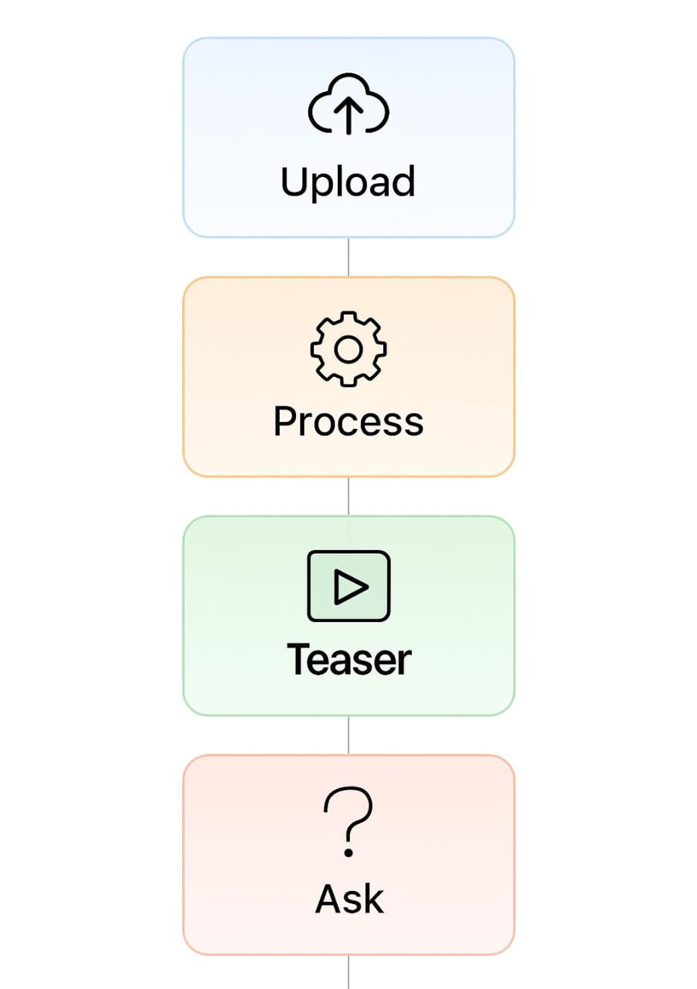



SOLUTION
Automated Teaser Generation
Our AI-powered application revolutionizes video promotion by automatically generating dynamic and engaging short-form teasers from any long-form video. Simply upload your video or paste a YouTube link, and let our system do the heavy lifting.
Seamless Input
Upload video files directly or provide a YouTube URL.
AI-Powered Analysis
Our intelligent backend processes content for key moments and relevant audio.
High-Quality Output
Receive a ready-to-share teaser video, audio extracts, and AI-generated insights.
Notes:
3

Slide 5
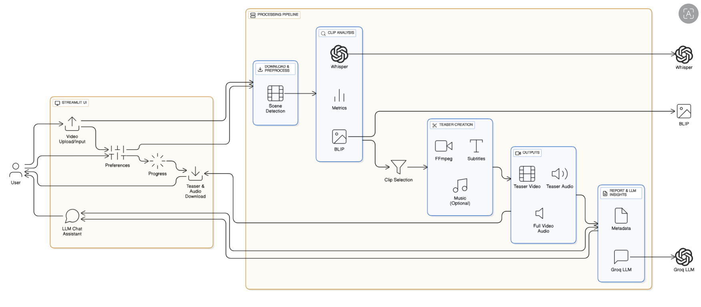
BEHIND THE SCENES
System Architecture
Our robust architecture ensures a smooth and efficient workflow from video ingestion to teaser delivery. The pipeline is designed for scalability and integrates cutting-edge AI models for intelligent content analysis.
Notes:
4

Slide 6
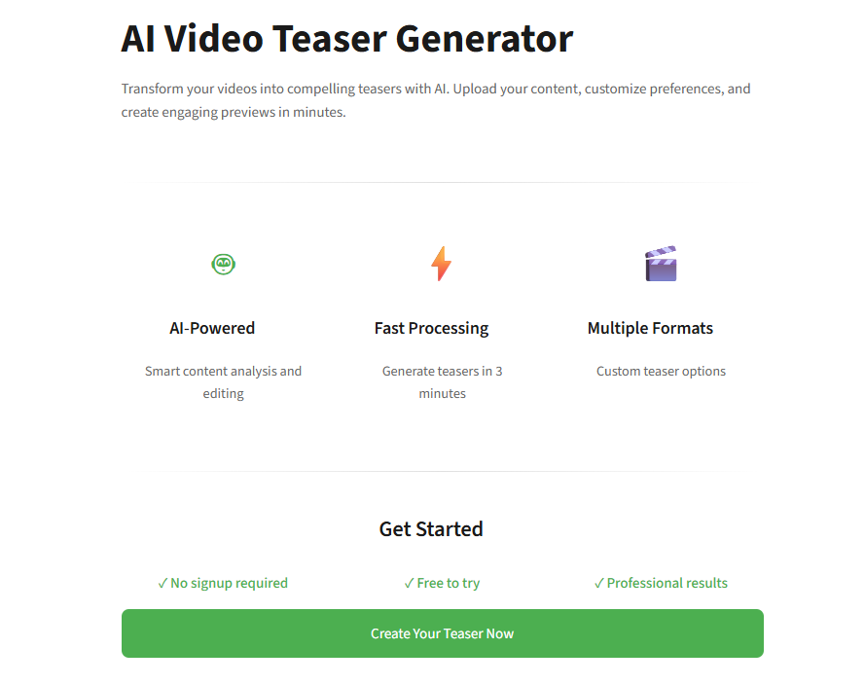
Frontend: Control Panel
USER INTERFACE
The intuitive Streamlit-powered frontend provides a seamless user experience. From video uploads to fine-tuning teaser settings, every interaction is designed for simplicity and efficiency.
Key Features
Interactive Elements
Video upload and YouTube link input
Download options for all generated assets
Customizable teaser duration, and tone
Integrated AI assistant chat for guidance
Instant teaser preview with subtitles
Real-time progress tracking
Notes:
5

Slide 7
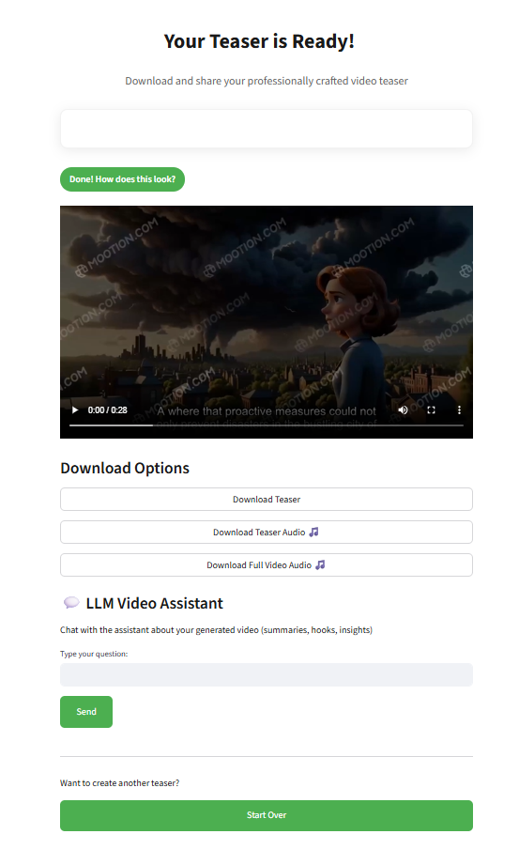
THE ENGINE ROOM
Backend: The Core Processing Unit
The Backend orchestrates the entire video processing pipeline. It meticulously handles video ingestion, intelligent scene detection, AI-driven analysis, and final teaser assembly, ensuring a high-quality output tailored to your needs.
Download & Preprocess : Fetches video, chunks into logical scenes, and prepares for analysis.
Clip Analysis : Leverages Whisper for speech-to-text, BLIP for visual captions, and extracts audio metrics.
Clip Selection : Intelligently scores clips, boosting relevance based on keywords and ensuring comprehensive coverage.
Teaser Creation : Uses FFmpeg for seamless stitching, adding subtitles, and optional background music.
Outputs Generation : Presents the final teaser, extracted audio, subtitles to the UI and the detailed metadata to the language model.
Notes:
6

Slide 8




AI POWERED
Intelligence at its Core
Our solution is built upon a foundation of state-of-the-art AI models, each contributing to the intelligent analysis and synthesis of your video content. These models work in concert to identify key moments and create compelling narratives.
Whisper
BLIP
Converts speech to accurate text, identifying spoken content for clip selection.
Generates descriptive image captions, understanding visual context for compelling teasers.
Groq API
FFmpeg
Enables ultra-fast AI inference for real-time video summarization, Q&A, and content insights.
Assembles video clips, applies subtitles, and integrates music for final production.
Notes:
7

Slide 9
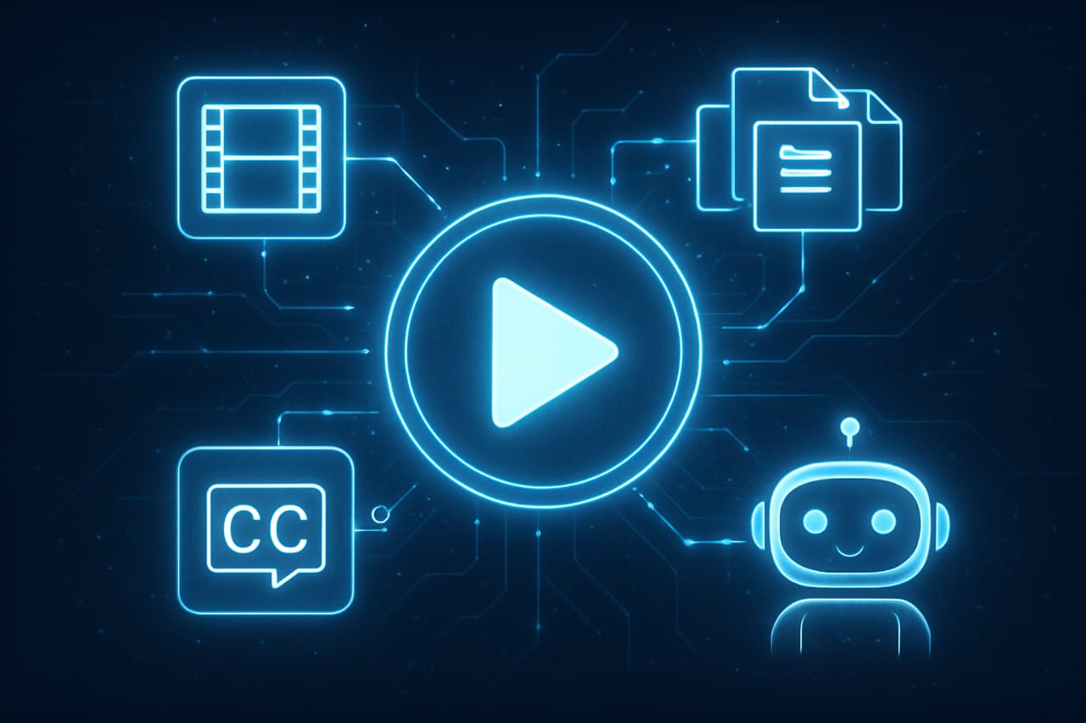



CAPABILITIES OF TEASER
Core Features at a Glance
Our AI Video Teaser Generator is packed with powerful features designed to maximize your video's reach and engagement with minimal effort.
Automated Scene Detection
Intelligently identifies and segments distinct scenes within your video for precise clip selection.
AI-Powered Subtitles
Generates accurate subtitles through Whisper, making your teasers accessible and impactful.
Flexible Download Option
Options to download the final teaser with subtitles and audio extracts.
LLM-Powered Assistant
An integrated AI assistant provides tips, content ideas, and answers questions in real-time.
Notes:
9

Slide 10
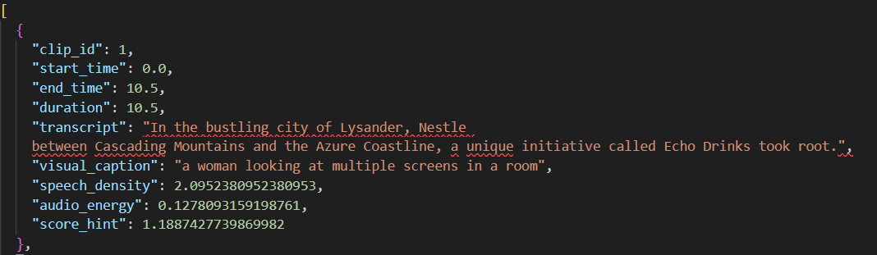
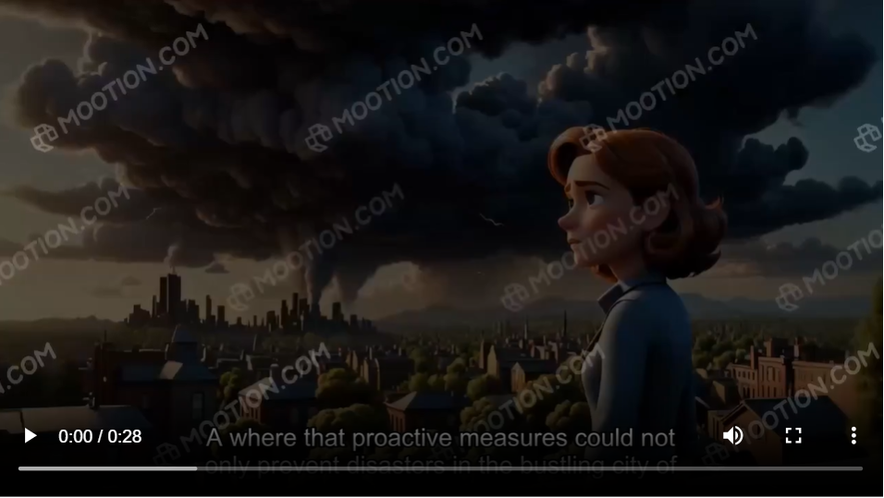
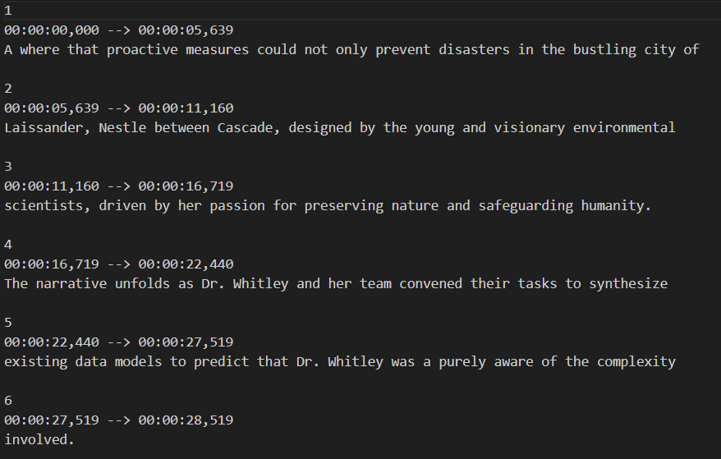
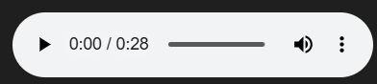
AI VIDEO TEASER GENERATOR
Turn Long Videos into Powerful Teasers in Minutes
The AI Video Teaser Generator empowers anyone to create compelling video highlights, fostering greater engagement and reach across all platforms.
GitHub Repository
Streamlit App
Notes:
10

Slide 11
THANK YOU
GitHub Repository

